Slide 1

BY:-CODER SENA - Devansh Jaiswal - Arya Sharma -Dikshant -Mridul

Slide 2
Problem
We have lost our ancient universities.
Lost of most scientific knowledge.
Lack of interest in vedas and meditation.
We are getting uprooted from our roots.
Market Size
80% of Indian population is 5-95 (approx)years old
Suppose 50% of that use Virtual vishwavidyalya website/app -
500 Million people
- That’s our Target
Audience
Solution → V V
Digitalizing all the vedic materials .
The material would easily be faccilated.
Through websites ,apps ,animations ,text and through AR/VR.
Meditation would be made easier with the help of new gen technologies.
Value Proposition
Customer Segments
children
School/College Authorities
Youth enthusiastic.
Writers
Old age
Within a
Pocket-Friendly Range
Gain your potential.

Slide 3
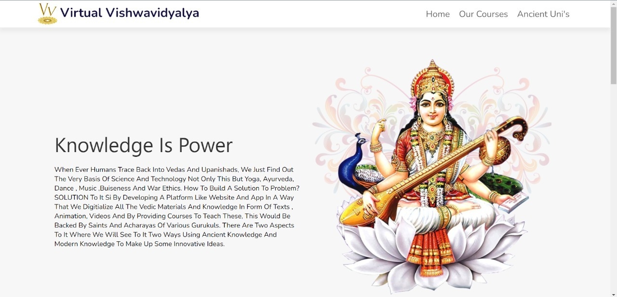
Images
.

Slide 4
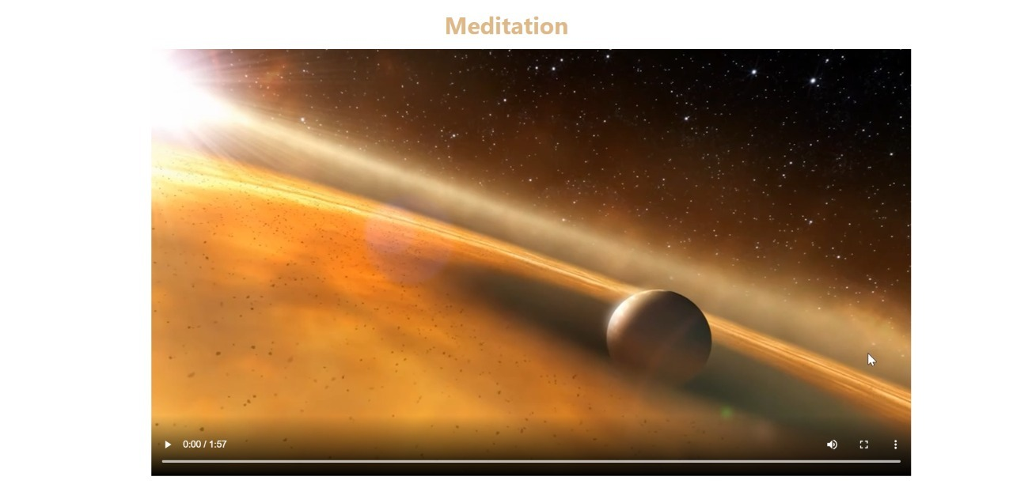
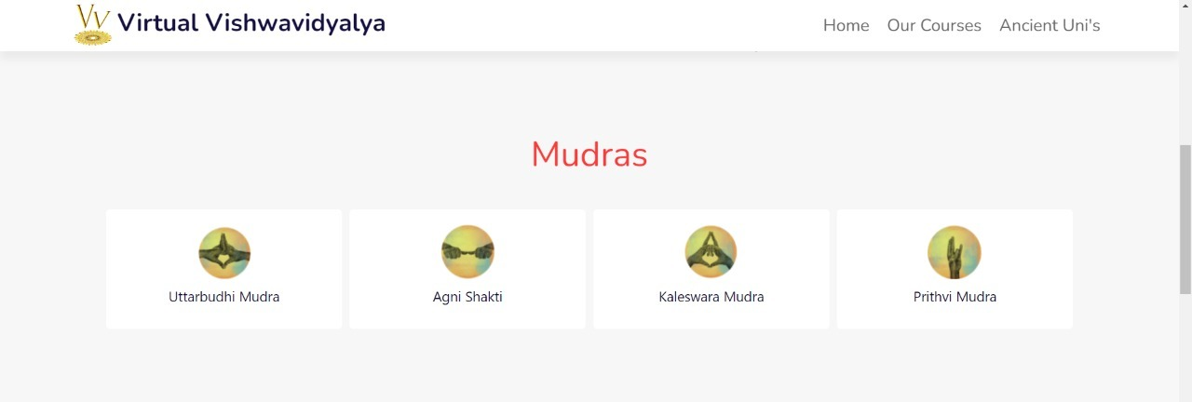

Slide 5
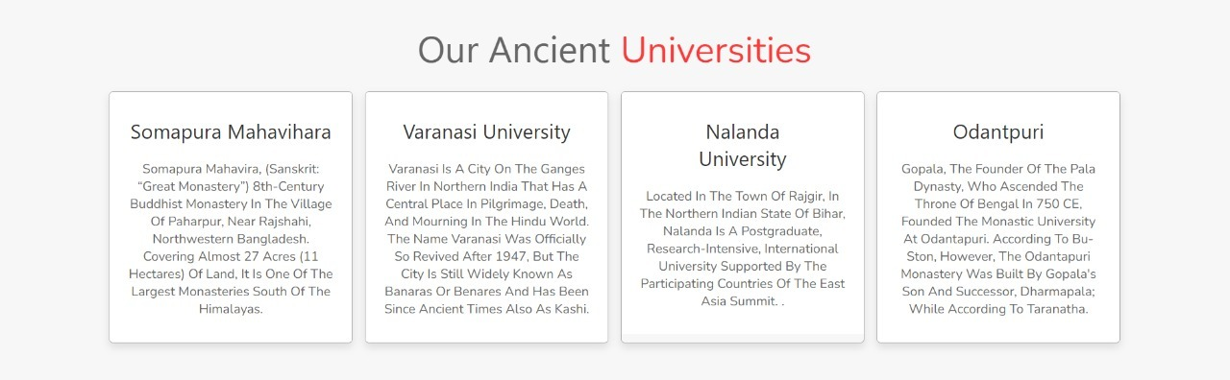
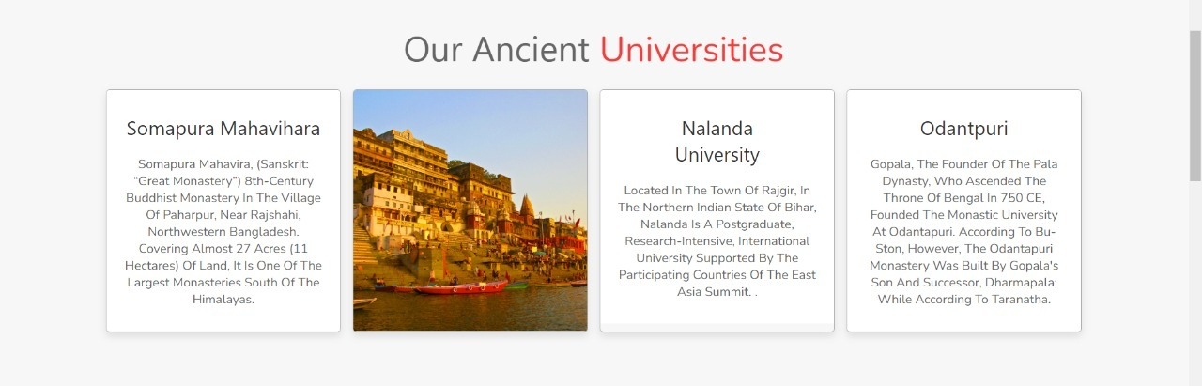

Slide 6
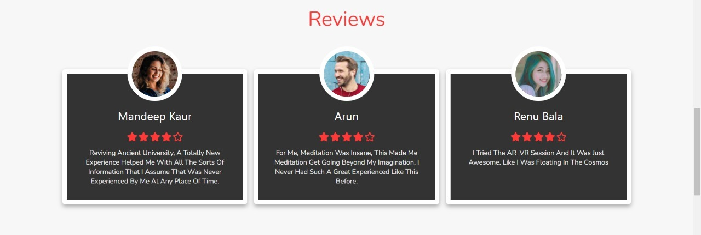

Slide 7
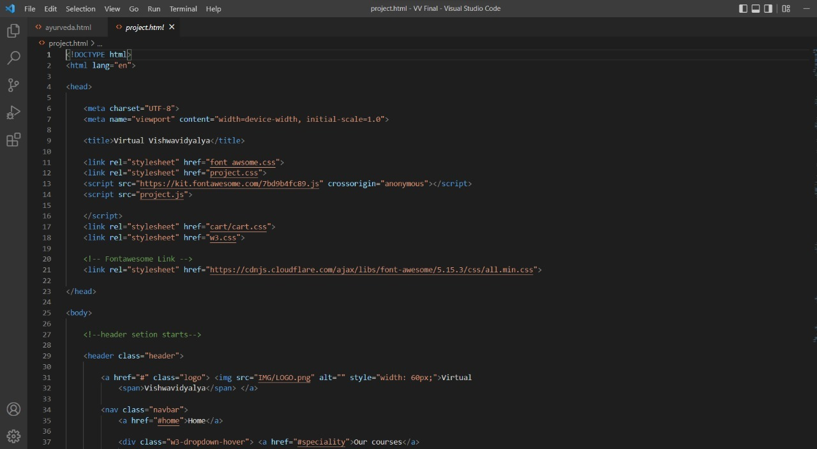
CODE SNAP

Slide 8

Strengths
Sustanable , we are reviving all the ancient universities of India.a better experience for a viewer , an enjoyable and adventurous . Taking you to cosmos and quantum sciences.
VIRTUAL VISHWAVIDYALYA
SWOT
Analysis
Weaknesses
Can improve the Team status. (Working On it)
Learning new things Everyday & Improving on the project vishwavidyalya.
Opportunities
Making V V Sustainable (From the Back-End to the Front-End).
Providing Customer Satisfaction, Making a Multipurposed
Websites and products.
100% sales Margin & Establishing Brand-Value.
Threats
A big-Tech company with massive brand value launching a similar way of providing courses(UNACADEMY,VEDANTU).
Delayed Production/Launch.

Slide 9



MISSION
-Reviving the ancient Universities and there soul knowledge.
Providing the better way of living.
Moving towards your roots.
VISION
AIM is to provide the digital courses and easier sort of knowledge to humankind, making people learn all the secrets of Ancient INDIA.
To make meditation adventurous by using AR/VR and all the new gen technologies.
values
People are benfited by the way of living , living a life of full potential.
Knowledge is power.

Slide 10
THANK YOU

